Slide 1

Ruby on Rails

Slide 2
Who are we ?
Team 7
  Do Van Toan (toan_55@vnu.edu.vn)
  Le Van Hung (hunglv_55@vnu.edu.vn)
  Nguyen Ngoc Thoai (thoainn_55@vnu.edu.vn)
  Le Hong Cam (camlh_55@vnu.edu.vn)

Slide 3
Presentation Agenda
Introduction to Ruby
Introduction to Rails
Rails In Depth
Development plan
Question & Answer

Slide 4

Introduction to Ruby
Brief overview
Basic features
Some syntax
Quick demo

Slide 5
Brief Overview
Ruby is a scripting, object-oriented, dynamic, general-purpose programming language
Designed by Yukihiro Matsumoto – A Japanese computer scientist and programmer
Designed for programmer productivity and fun
First released in 1996 and became famous because of Rails creation in 2005

Slide 6
Basic features
Object-Oriented : Everything is an object, no Primitives
Single-Inheritance : Module and mixin to add behaviors
Garbage Collection
Ruby Interpreter : Interaction mode
Concise and natural syntax : Readable and maintainable programs

Slide 7
Variables & Constants
Variables
  Global variables begin with a sign $
  Local variables begin with a lowercase letter or ‘_’
  Instance variables begin with a sign @
  Class variables begin with 2 signs @@
Constants
  Begin with an uppercase letter

Slide 8
Methods
Syntax
  def method_name[argument_list]
  # method body
  end
Implicitly return the last variable
Can return multiple values

Slide 9
Blocks
A group of code, usually used with methods
block_name{#code}
Methods and blocks
  Use “yield” method to invoke a block inside a method

Slide 10
Classes
Syntax
class [ClassName]
#Methods
end
Don’t have to declare attributes explicitly
[ClassName].new to initiate an object

Slide 11
Modules
Group classes, methods, variables – as namespaces.
Syntax
  module [ModuleName]
  end
Used with classes to add behaviors or methods
  Form mixins – classes contain methods from outside
  Like Interfaces in Java

Slide 12
Other Syntax
Arrays
Ranges
Symbols - "immutable strings"
Hashes
Loop and Iterator
IF…ELSE

Slide 13
Demo
Enough with speaking about Ruby
Let’s do some demos

Slide 14
Presentation Agenda
Introduction to Ruby
Introduction to Rails
Rails In Depth
Development plan
Question & Answer

Slide 15
Introduction to rails
Brief overview
Highlighting features
Architecture
Development Environment
Demo

Slide 16
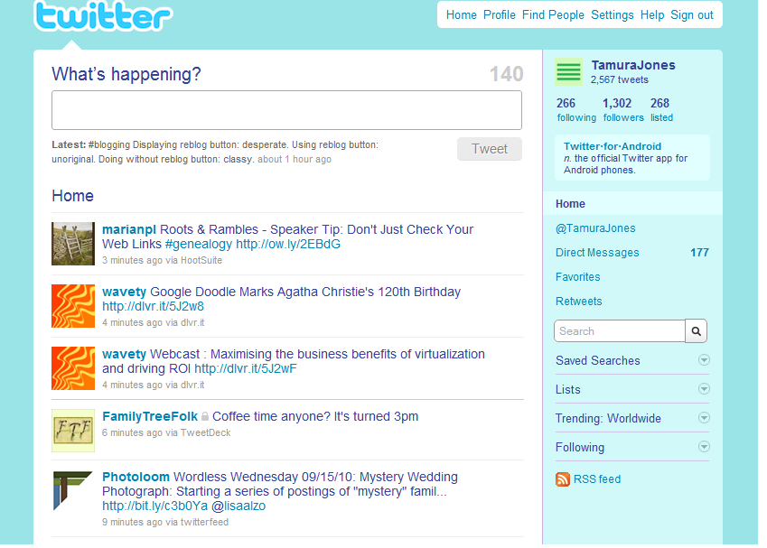
Great sites built on Rails
Social network.
Yes, Twitter!! http://twitter.com/

Slide 17
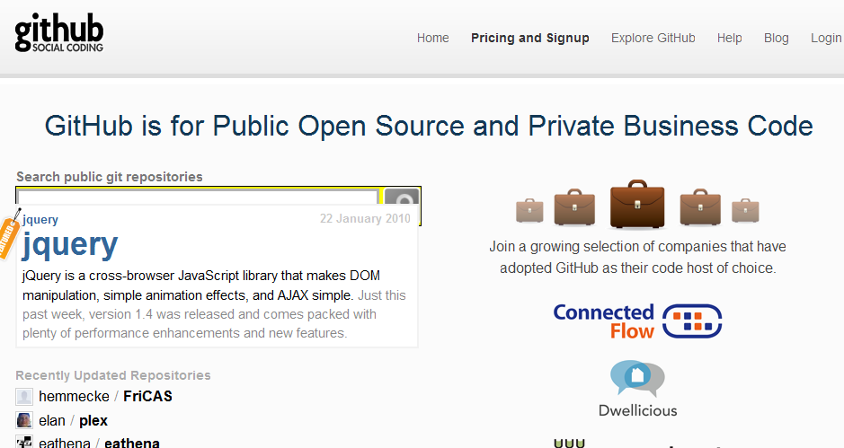
Great sites built on Rails(Contd.)
Social coding
Yes, Github!! http://github.com/

Slide 18
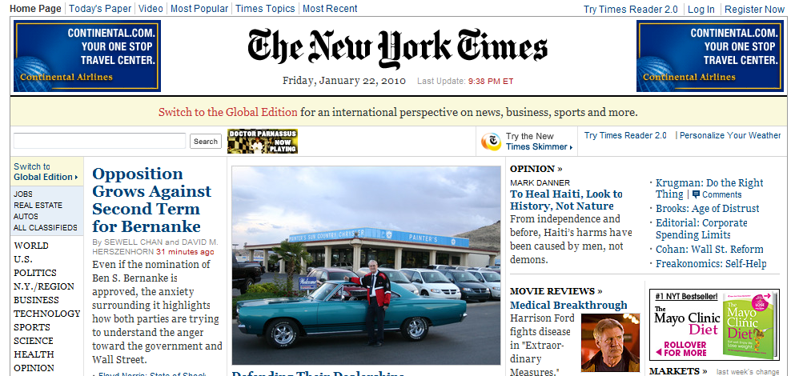
Great sites built on Rails(Contd.)
News Unlimited
Yes, New york times!! http://www.nytimes.com

Slide 19
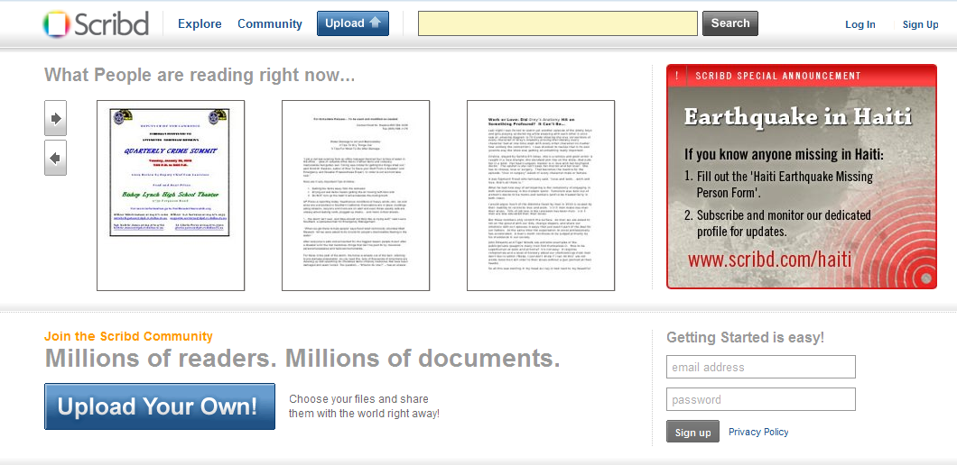
Great sites built on Rails(Contd.)
Document Sharing
Yes, Scribd!! http://www.scribd.com/

Slide 20
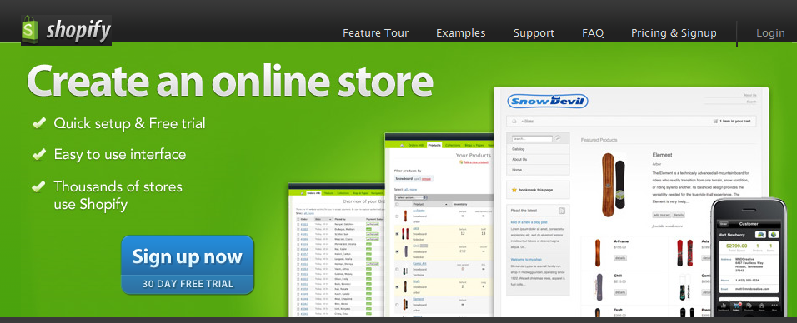
Great sites built on Rails(Contd.)
Create an online store!
Yes, Shopify!! http://www.shopify.com/

Slide 21
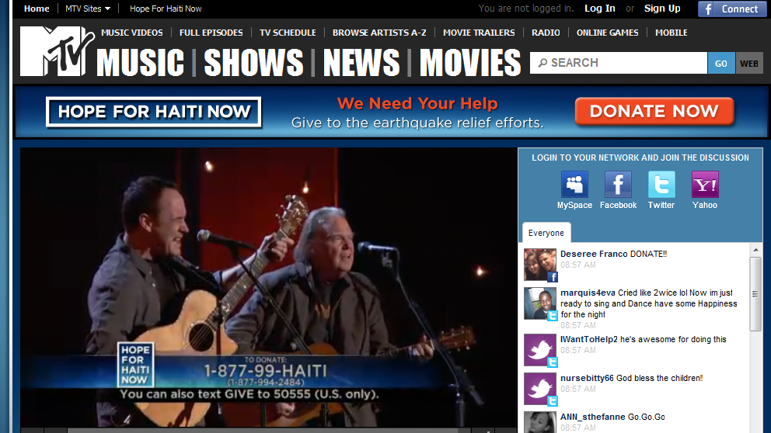
Great sites built on Rails(Contd.)
Check fashion
Yes, MTV Style!! http://www.mtv.com/

Slide 22

Great sites built on Rails
Box office in Home
Yes, HBO!! http://www.hbosouthasia.com/

Slide 23
Brief overview
Ruby on Rails or Rails for short is a full-stack, MVC, open source web framework
Written in Ruby by David H. Hansson in 2005
Designed for rapid development of web apps with less code, low-cost, short time
“Rails is the killer app for Ruby” – Matz

Slide 24
Highlighting features
DRY – Don’t Repeat Yourself
CoC – Convention over Configuration
Rails is Agile
Supports generating code
Auto generates unit-test stubs for all functionalities - apps tend to be tested (TDD)

Slide 25
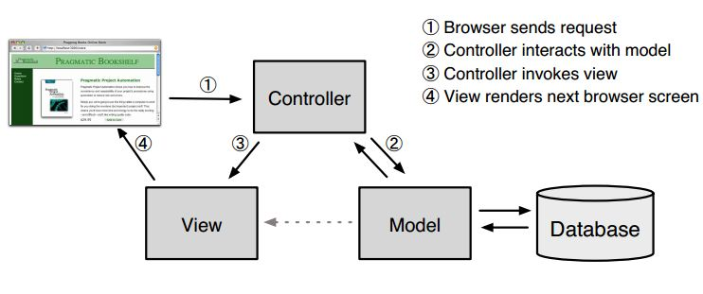
Architecture

Slide 26
Development Environment
Ruby interpreter
Rails framework – A gem (ruby libs)
A web server
A database management system
An editor

Slide 27
Development Environment
On windows
  Everything needed is to download and install a software pack from http://railsinstaller.org/
On linux – Ubuntu
  sudo apt-get install build-essential libopenssl-ruby libfcgi-dev
  sudo apt-get install ruby irb rubygems ruby1.8-dev
  sudo apt-get install sqlite3 libsqlite3-dev
  sudo gem install rails
  sudo gem install sqlite3-ruby
Editors like sublime or IDEs like Aptana
  http://www.aptana.com/products/radrails
  http://www.sublimetext.com/

Slide 28
Demo
You will be seeing how fast developing in Rails is

Slide 29
Presentation Agenda
Introduction to Ruby
Introduction to Rails
Rails In Depth
Development plan
Question & Answer

Slide 30
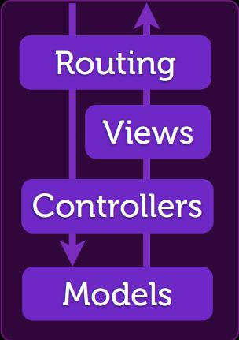
Rails in Depth
Models
Controllers
Routing
Views

Slide 31
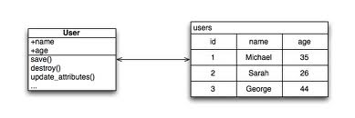
Models
Active Record
Data Migrations
Model Validations
Model Associations

Slide 32
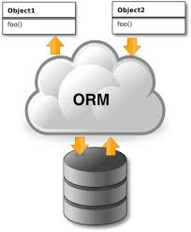
Active Record design pattern
ORM : Supports CRUD
Models in Rails inherit class Base in module ActiveRecord

Slide 33
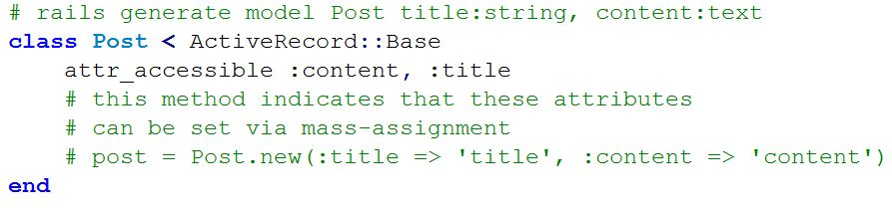
Create a Model
Rails provides a command to conveniently create models
  rails generate (g) model [model_name] [field_list]

Slide 34
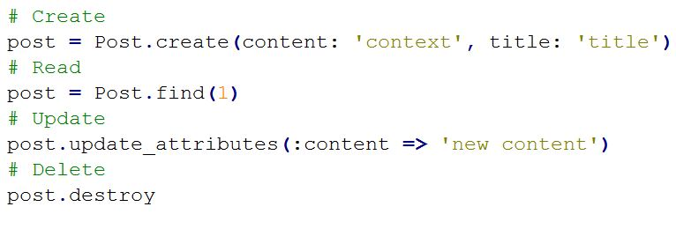
CRUD

Slide 35
Data Migrations
Migrations are a way to create, alter database
Manage the transformations of database effectively and easily
  Schema versioning
  rake db:migrate command to manage
No need to write SQL scripts, be independent with physical database
Are Ruby classes generated when creating models

Slide 36
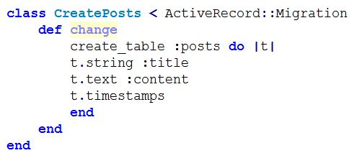
Migration example

Slide 37
Methods for manipulating tables
create_table
change_table
cdd_column
remove_column
drop_table
add_index

Slide 38
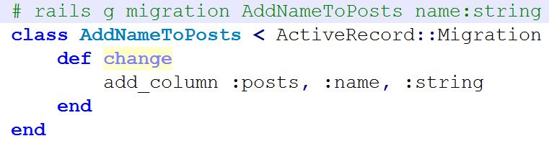
Migration to add a column

Slide 39
Model validations
Each attribute of a model can be validated right inside the model
Use helper methods to make up validation rules
  validates_presence_of
  validates_numericality_of
  validates_uniqueness_of
  Validates
User input must obey these rules

Slide 40
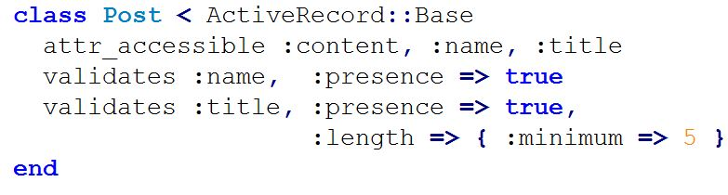
Validates a model

Slide 41
Model Associations
Represent tables relationships.
  1-1, 1-n, n-n
Use helper methods
  belongs_to :model (1-1)
  has_one :model (1-1)
  has_many :models (1-n)
  has_many :models, :through=> :others (n-n)

Slide 42
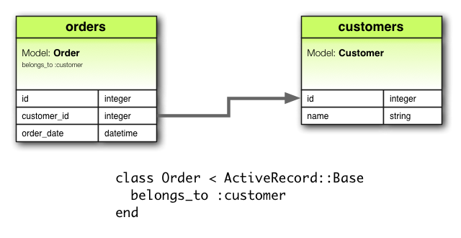
Model Associations

Slide 43
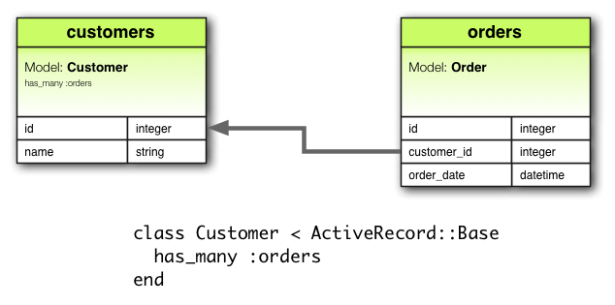
Model Associations

Slide 44
Scaffolding
A programming technique that describes how database may be used
In Rails, a scaffold auto-generates the controller, views corresponding to a model, which represents database.
Rails encourages using provided commands to create components

Slide 45
Test the model
A test class is generated by rails to test each model
Model testing is call unit-testing
Uses command rake test:units to run tests
Rails uses separate database for each development phase
  Development
  Test : fixture for populating data
  Production

Slide 46
Demo for model
It’s better to see how it works

Slide 47
Controllers
Orchestrates the app
  Listen to requests
  Interact with models : fetch data from or save to database
  Call appropriate views to display data
A controller has several methods, each does an action which can be called by a HTTP method
Instance variables are visible in views

Slide 48
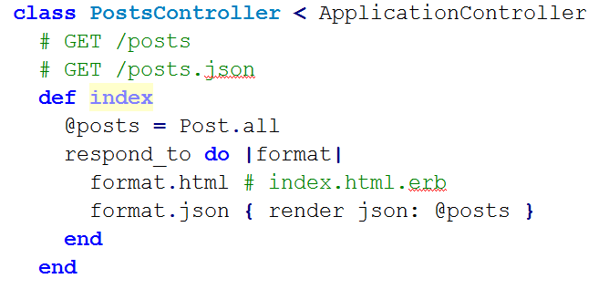
Controller Example

Slide 49
Test the controller
Rails offers a way to test controllers as well
Auto-generates controller testing class while creating controller by the provided commands
Each method in a model can be tested
Controller testing is called functional testing in Rails
Use command rake test:funtionals

Slide 50
Demo
Create a controller
And test

Slide 51
Routing in Rails
Recognizes URLs and dispatches them to controller’s actions
  Connecting URLs to Code
    GET /home/index
    Match /home/index => home#index
  All can be done by configuring route.rb
    If I have lots of controllers with many methods, I possibly have to configure many times ?
    Convention over configuration seems to be broken ?

Slide 52
Routing Resource
Rails gives us routing resources to simplify the work
Quickly declare all common routes for a controller
  Add resource :posts in routes.rb
  PostsController’s methods are now able to be routed
  index, show, new, edit, create, update, destroy actions

Slide 53
Routing Resource
HTTP Method | Path | action | used for
GET | /posts | index | display a list of all posts
GET | /posts/new | new | return an HTML form for creating a new post
POST | /posts | create | create a new post
GET | /posts/:id | show | display a specific post
GET | /posts/:id/edit | edit | return an HTML form for editing a post
PUT | /posts/:id | update | update a specific post
DELETE | /posts/:id | destroy | delete a specific post

Slide 54
Routing Helpers
HTTP Method | Path | action | named helper
GET | /posts | index | posts_path
GET | /posts/new | new | new_post_path
POST | /posts | create | posts_path
GET | /posts/:id | show | post_path(:id)
GET | /posts/:id/edit | edit | edit_post_path(:id)
PUT | /posts/:id | update | post_path(:id)
DELETE | /posts/:id | destroy | post_path(:id)

Slide 55
Nested Resources
When two models have a “parent-children” relationship
  has_many :comments
  belongs_to :post
resources should contain corresponding one.
resources :posts do
  resources :comments
  end

Slide 56
Nested Resources
HTTP Verb | Path | action | used for
GET | /posts/:post_id/comments | index | display a list of all comments for a specific post
GET | /posts/:post_id/comments/new | new | return an HTML form for creating a new commentbelonging to a specific post
POST | /posts/:post_id/comments | create | create a new commentbelonging to a specific post
GET | /posts/:post_id/comments/:id | show | display a specific commentbelonging to a specific post
GET | /posts/:post_id/comments/:id/edit | edit | return an HTML form for editing an commentbelonging to a specific post
PUT | /posts/:post_id/comments/:id | update | update a specific commentbelonging to a specific post

Slide 57
Views
Delivery information from controllers to users
Formed by HTML and Embedded Ruby code to display data from controller
  Why embedded Ruby code in views, which may break the structure of MVC
  Just use for displaying data, do not include any logic at all

Slide 58
Views call to controllers
Actions with method GET
  link_to method causes a GET request
  Routing helper to create paths : posts_path => /posts
  link_to ‘posts’, posts_path => GET /posts
Actions with method POST
  button_to method causes a POST request
  button_to ‘create’, posts_path => POST /posts

Slide 59
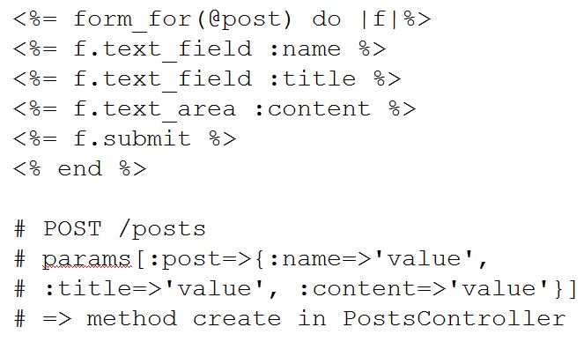
Form helper

Slide 60
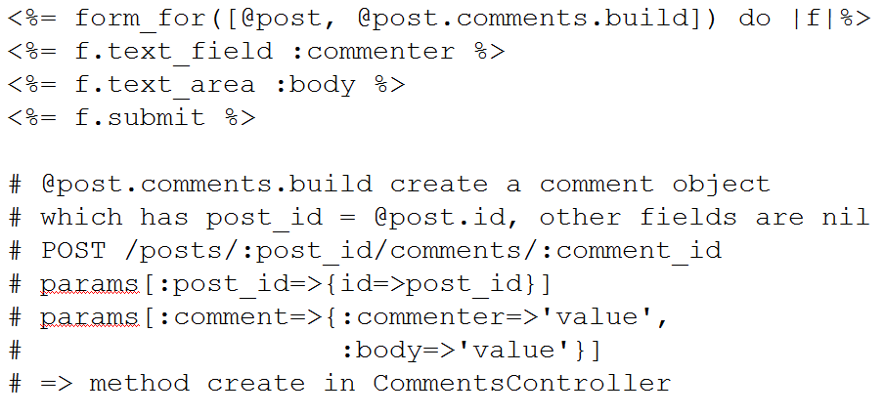
Form helper

Slide 61
Views layout
Help to build base layouts easily (master pages)
application.html.erb is default layout, all other views will be added into
However, each controller can explicitly decide which layout will be used by indicating a layout file in layout directory
  Add layout “mylayout” to a controller if you want to use non-default layout for its all views

Slide 62
Behaviour-Driven development
Based on TDD
Give a description for each functionality (behaviour) of the software
Write tests from each description
Run the tests and see the software failed
Implement the functionality and run tests until the software passes the tests
Develop all functionalities this way

Slide 63
Cucumber with Rails for BDD
Cucumber is a BDD test framework written in Ruby
Can be used for BDD
Descriptions written in natural languages
Easily used with Rails, just as a Ruby library
  gem install cucumber

Slide 64
Demo Cucumber
For the Post app

Slide 65
Presentation Agenda
Introduction to Ruby
Introduction to Rails
Rails In Depth
Development plan
Question & Answer

Slide 66
Development plan
Build a complete web app using Rails : Online book-shop with enhanced functions
  Apply advanced Rails techniques like cache, security, Ajax, sending mails, etc
Apply Agile practices
  Just define the functionalities
  Develop each module completely
  Develop in iterations

Slide 67
Development plan
Apply Behaviour-Driven Development
  Write tests for each functionality, each one must be passed
Deployment on a real host : heroku

Slide 68
Online Resources
http://ruby-doc.org/
http://api.rubyonrails.org/v3.2.13/
http://guides.rubyonrails.org/v3.2.13/
http://ruby.railstutorial.org/ruby-on-rails-tutorial-book
http://railsforzombies.org/

Slide 69
Reference materials
The Ruby Programming Language (2008) by David Flanagan and Yukihiro Matsumoto - Ruby’s creator
Agile Web Development with Rails Fourth Edition by Sam Ruby, Dave Thomas and David H. Hansson - Rails’ creator

Slide 70

Thank you !
Q&A

Slide 71
Common Questions
Who use Rails?
Why rails is Agile?
Why Rails is the killer app for Ruby?
Advantages and Disadvantages?
What types of projects should use Rails?
The future of rails?
Job trends?
Rails in Vietnam?

